Slide 1

Digital Twin of Car
Using Federated Learning

Slide 2
Motivation
Rapid growth of Electric Vehicles increases need for intelligent monitoring systems.
EV owners face uncertainty in mileage, battery condition, and maintenance scheduling.
Centralized machine learning requires sharing raw charging data, causing privacy concerns.
Vehicle charging behavior differs across users and vehicle models.
Federated Learning enables collaborative learning while preserving customer privacy.
The project aims to provide personalized EV analytics without exposing raw vehicle data.

Slide 3
Proposed Federated Architecture
Each vehicle model is treated as one federated client.
Every client trains a local machine learning model independently.
A showroom acts as the global federated server.
Clients send only summarized insights instead of raw charging data.
The showroom aggregates updates from all clients to generate global knowledge.
Global insights are redistributed back to clients for personalized prediction.
The system predicts mileage, battery health, degradation, and service notifications.

Slide 4
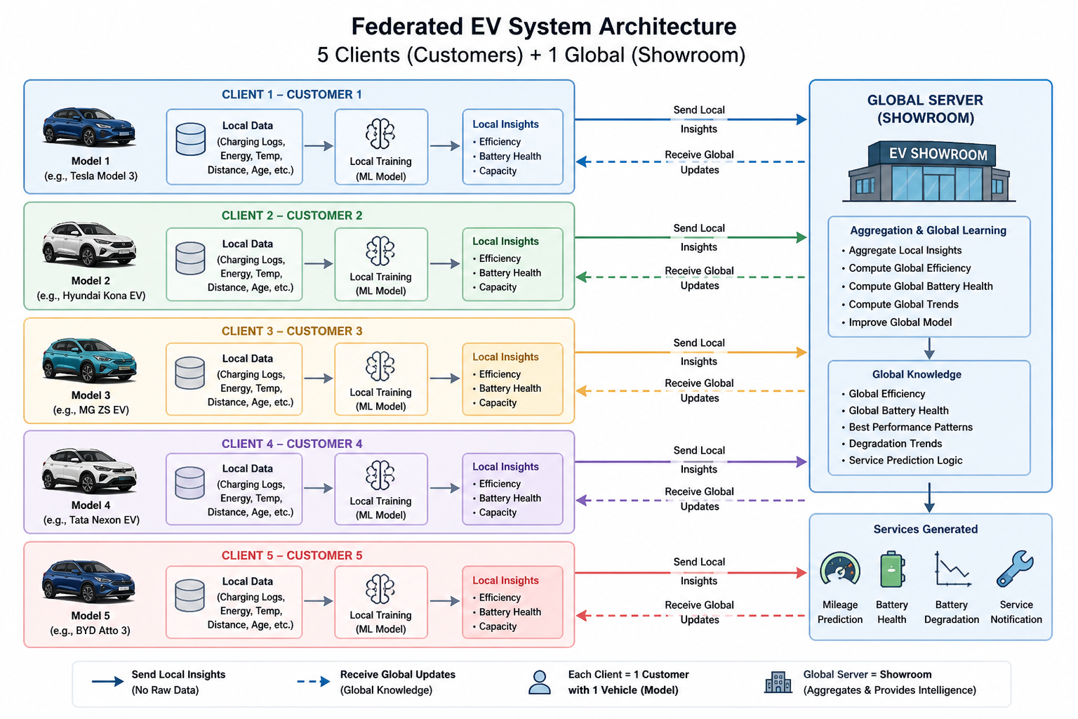

Slide 5
Dataset Description
EV Charging Patterns dataset is used for the project.
Dataset contains charging and operational information of Electric Vehicles.
Important features include:
Battery Capacity, Energy Consumed, Charging Duration, Charging Rate, Temperature, Distance Driven, Vehicle Age
Dataset is divided into multiple clients based on vehicle models.
Additional derived features are generated during preprocessing.

Slide 6
Client Creation
Each vehicle model forms one federated client.
Clients:
Tesla Model
Nissan Leaf
BMW i3
Hyundai Kona
Chevy Bolt
Every client contains only its own charging records.
Local training is performed independently on each client.
Raw charging data never leaves the client device.
This setup simulates a real-world privacy-preserving EV ecosystem.

Slide 7
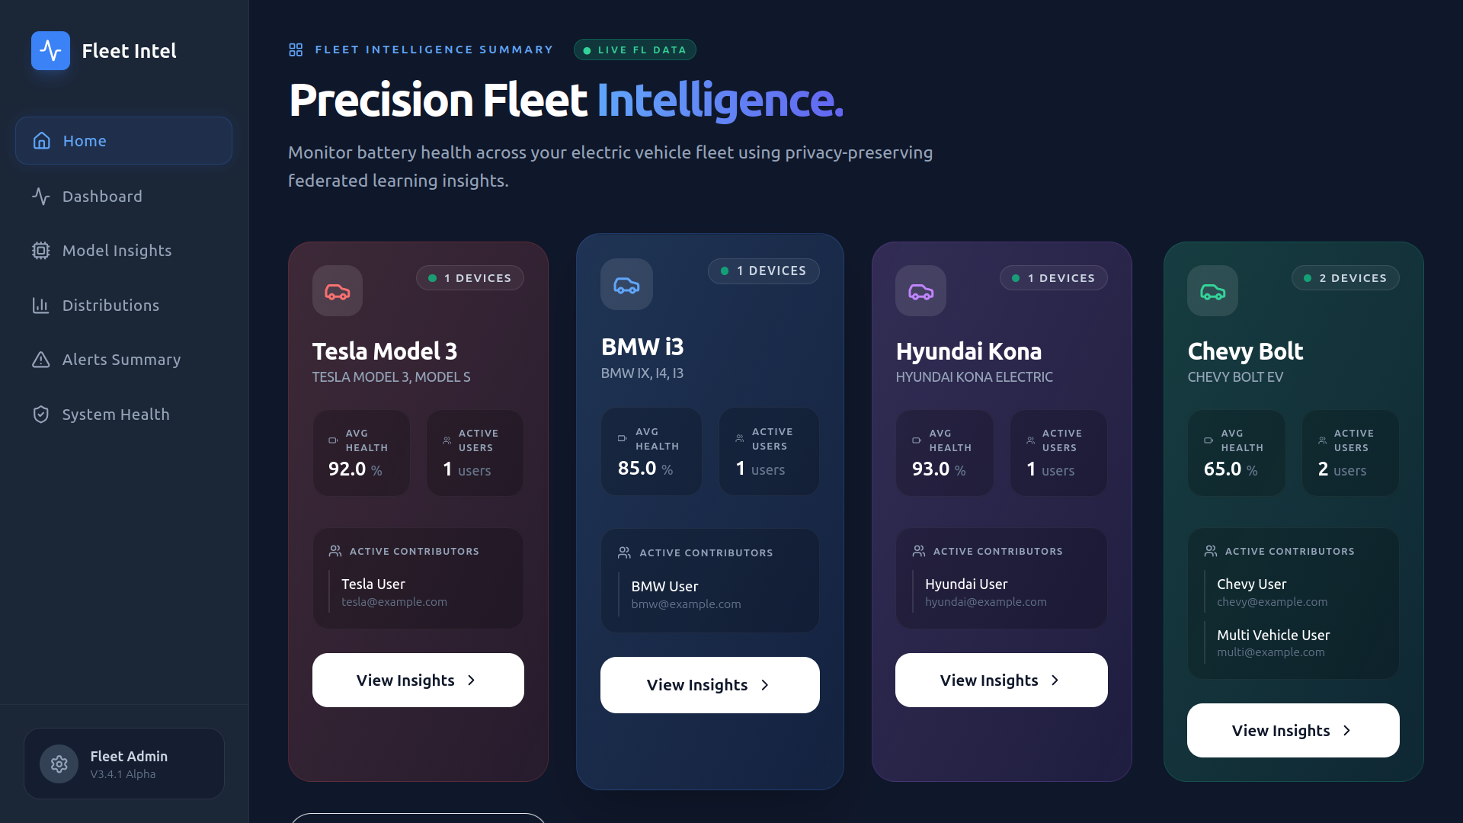

Slide 8

Local Model Training
Random Forest Regressor is used for local training.
Each client trains using its own charging and operational data.
Features used:
Battery Capacity
Charging Duration
Charging Rate
Temperature
Vehicle Age
Energy Consumed
Distance Driven
Random Forest captures non-linear EV charging behavior effectively.
Local models predict energy consumption patterns.
RMSE and $R^{2}$ metrics are used for evaluation.
Local training preserves data privacy.

Slide 9

Personalized Mileage Prediction
Mileage prediction combines:
Local battery capacity
Global federated efficiency
Formula used:
$$Mileage_{i}=\frac{Local Capacity_{i}}{Global Efficiency}$$
Different vehicle models receive different mileage predictions.
Personalization improves realism and customer-specific analytics.
Vehicles with higher efficiency achieve better mileage prediction.

Slide 10
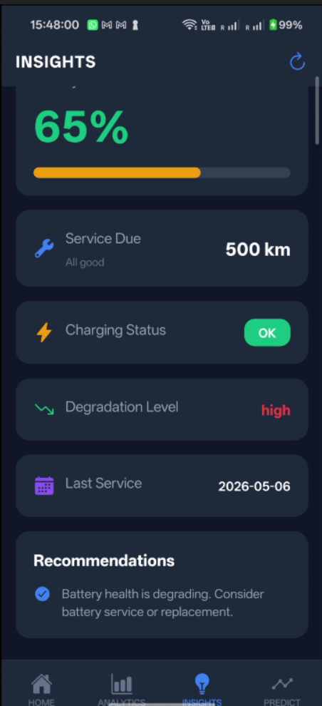
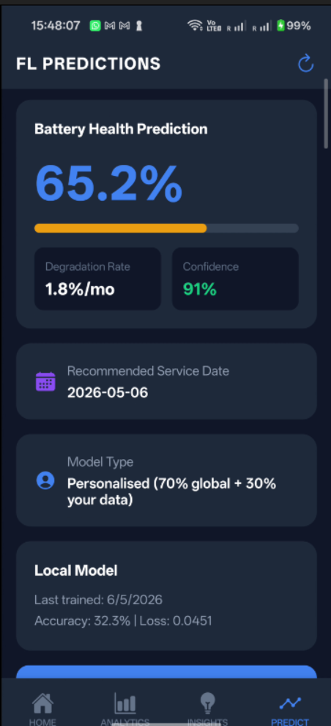
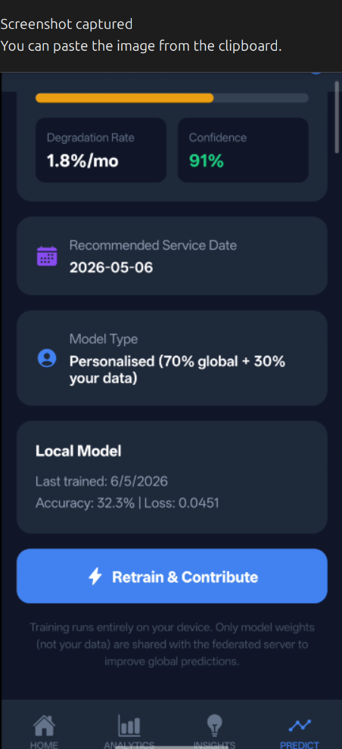

Slide 11

Personalized Battery Health Prediction
Battery health uses both local and global information.
Formula used:
$$Health_{i}=0.7\left(Local Health\right)+0.3\left(Global Health\right)$$
Local health reflects individual vehicle condition.
Global health represents fleet-level battery trends.
Personalized health improves reliability of prediction.
Vehicles with higher age and lower efficiency show reduced battery health.

Slide 12

Battery Degradation Modelling
Battery degradation is modelled using non-linear exponential decay.
Formula used:
$$Battery Health=H_{0}e^{−kt}$$
where:
$H_{0}$= Initial battery health
$k$= degradation constant
$t$= charging cycles
Degradation initially occurs slowly and increases over time.
This closely represents practical lithium-ion battery behaviour.
Degradation plots visualize long-term battery aging trends.

Slide 13
Results
Federated Learning successfully preserved client privacy.
Local Random Forest models improved prediction accuracy.
Personalized mileage predictions differed across vehicle models.
Battery health estimation reflected vehicle-specific conditions.
Non-linear degradation curves showed realistic battery aging behavior.
Service notifications were generated for degraded vehicles.
The showroom server successfully aggregated global EV knowledge.
The framework demonstrated intelligent and scalable EV analytics.

Slide 14
Conclusion
A Federated Learning–based EV analytics framework was successfully developed.
Each vehicle model acted as an independent federated client.
Local machine learning models were trained without sharing raw data.
The system predicted:
Personalized mileage
Battery health
Battery degradation
Service notifications
Federated aggregation enabled collaborative learning while preserving privacy.
The framework demonstrated realistic and scalable EV intelligence.

Slide 15
Future Work
Real-time IoT integration with EV sensors
Multi-round Federated Learning implementation
Deep learning models for advanced prediction
Digital twin dashboard for visualization
Real-time cloud deployment
Battery replacement prediction
Smart charging station recommendation
Vehicle-to-vehicle collaborative intelligence
Large-scale deployment with multiple EV fleets

Slide 16
Thank You

